Slide 1
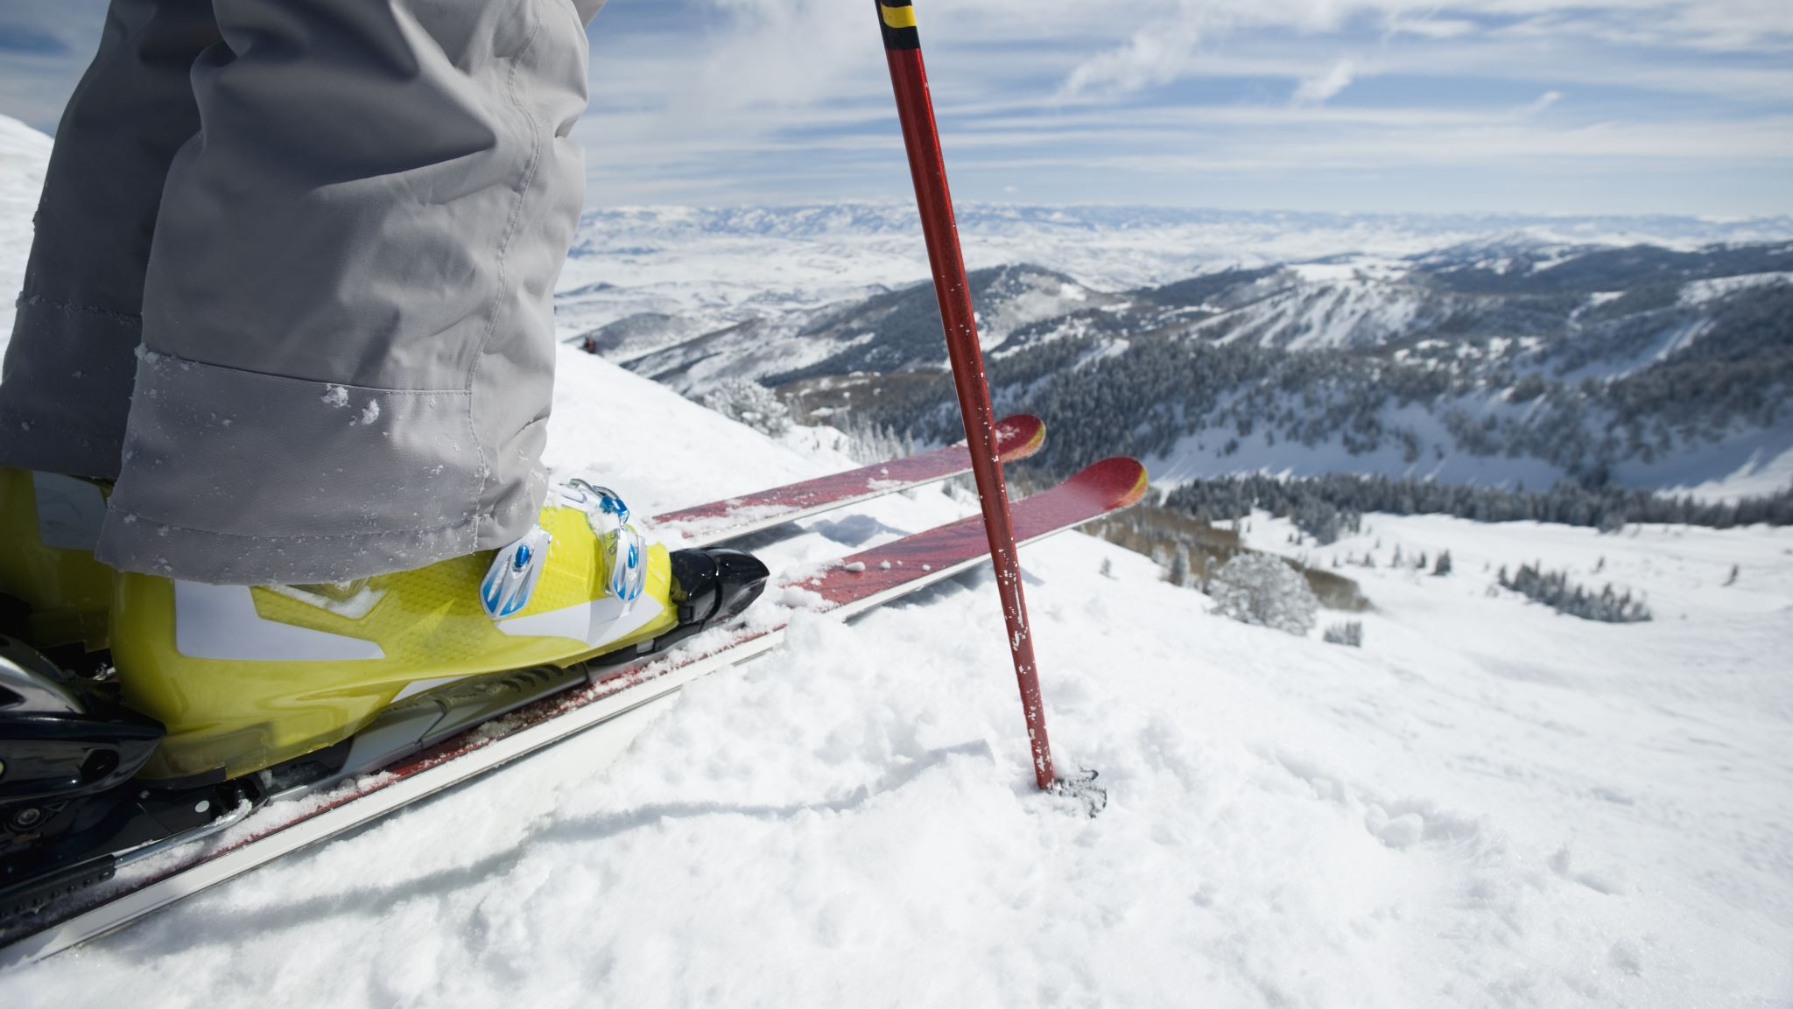
Big Mountain Resort Data-driven pricing strategy
Derek Powell Dec-02, 2021

Slide 2
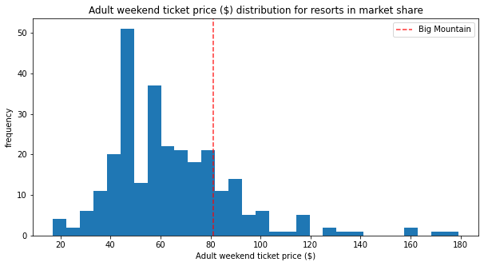
Business problem
At the current lift ticket price of $81.00 for adults, is Big Mountain Resort properly valuing their resort features in their lift ticket price?
Using a data analysis and a trained machine learning model, can Big Mountain Resort show that their features support a higher lift ticket price, as suspected?

Slide 3
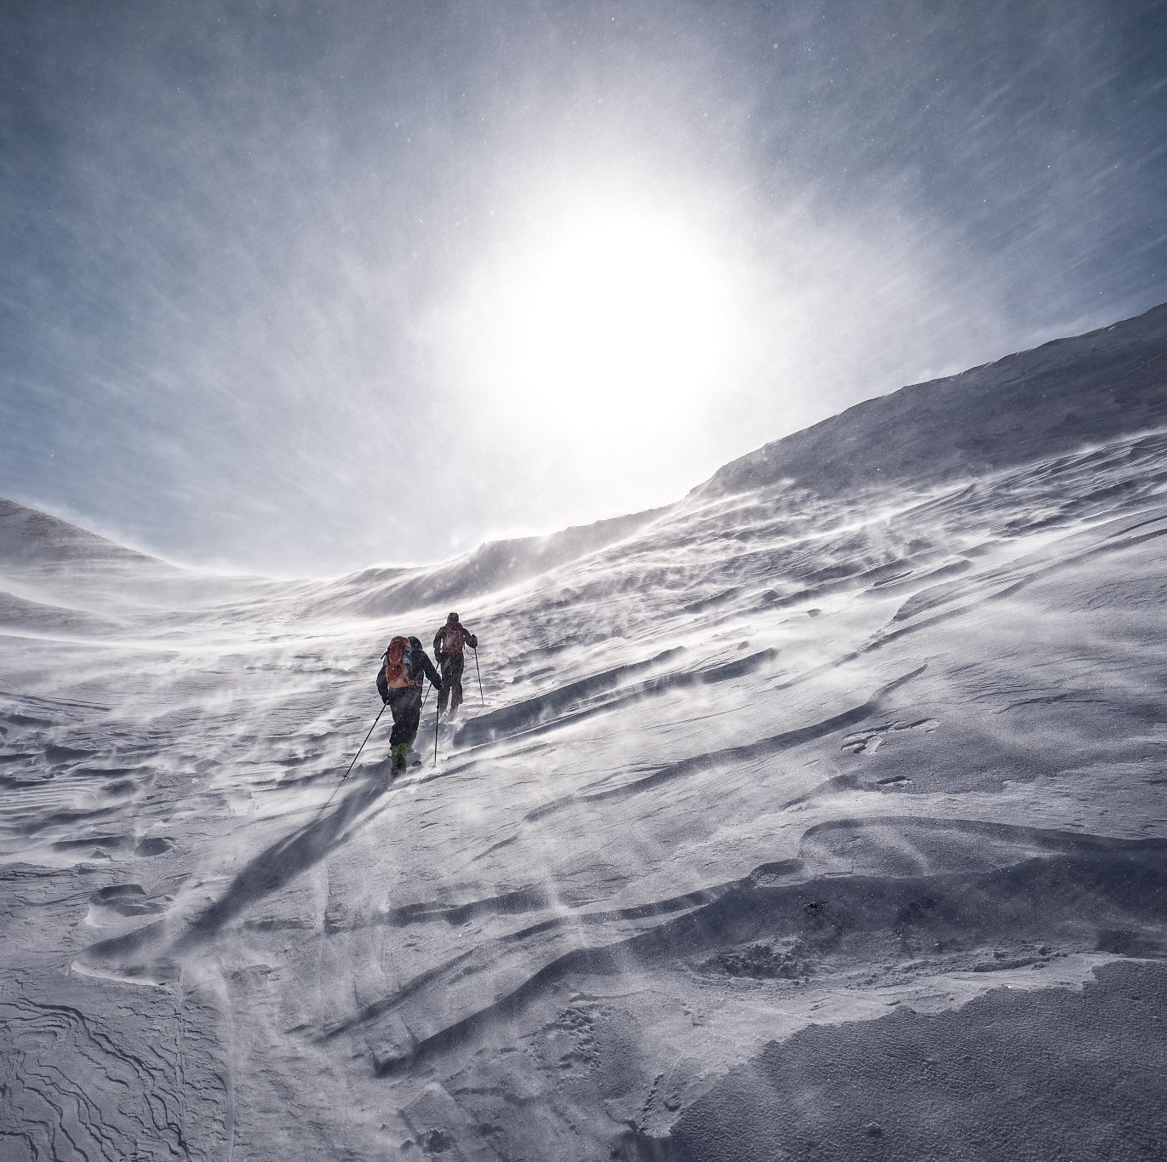
Recommendation
The machine learning model trained for and used in this analysis suggests an immediate price increase ($81.00 → $85.00) would be validated by our current resort features.
Additional increase of $8.61 would be supported if adding 1 additional run, 150 feet extra of vertical drop, and installing 1 additional chairlift.
We have also predicted the pricing support we could expect if decreasing the total number of runs available as a cost-savings measure. Further analysis should be done on operating expenses to determine if lost pricing support would be outweighed by expense savings on closed runs.

Slide 4
Modeling Analysis
Name | Big Mountain Resort
Region | Montana
state | Montana
summit_elev | 6817
vertical_drop | 2353
base_elev | 4464
trams | 0
fastEight | 0.0
fastSixes | 0
fastQuads | 3
quad | 2
triple | 6
double | 0
surface | 3
total_chairs | 14
Runs | 105.0
TerrainParks | 4.0
LongestRun_mi | 3.3
SkiableTerrain_ac | 3000.0
Snow Making_ac | 600.0
daysOpenLastYear | 123.0
yearsOpen | 72.0
averageSnowfall | 333.0
AdultWeekday | 81.0
AdultWeekend | 81.0
projectedDaysOpen | 123.0
NightSkiing_ac | 600.0
The features shown on the right were used in training the predictive model used in this analysis.
Data from 329 market competitor resorts was made available as part of this training.
All features were compared and contrasted to determine the most accurate valuation of them.

Slide 5
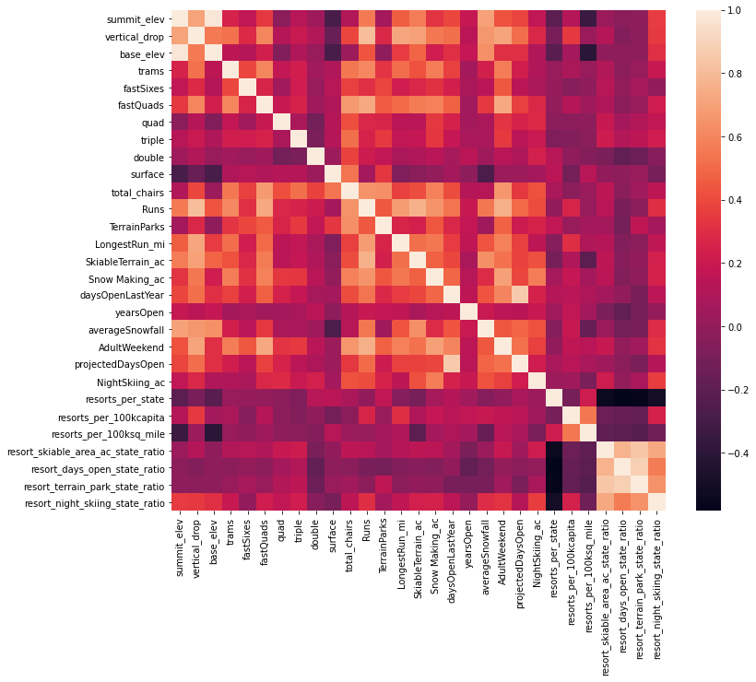
Feature Engineering
Additional data was used in the modeling not initially provided, such as the total square mileage per resort state as well as the total population. Using this data, we engineered resorts per square mileage and resorts per capita ratios to draw further inferences from the feature data by state.
Then using all available data points, we projected a heat map to determine correlation of price against other features. From this we were able to conclude the highest correlations to price came from the following features:
Total Runs
Snow Making area covered
Vertical Drop
Longest Run

Slide 6
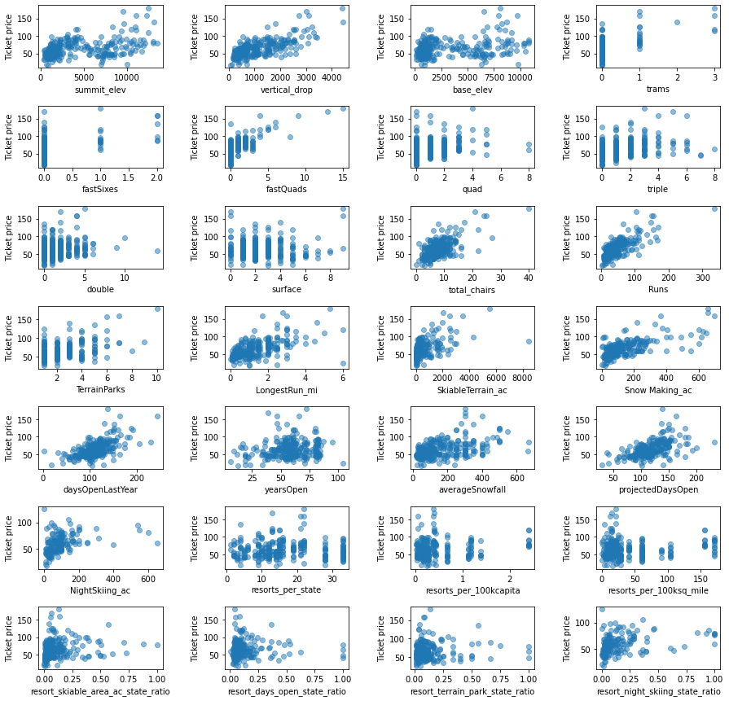
Individual Correlations

Slide 7
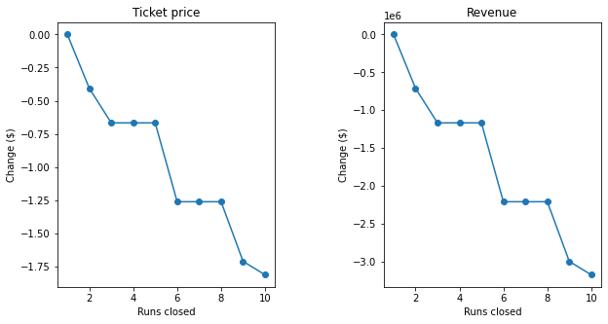
Scenario Testing
Having identified the resort features with the highest correlation to lift ticket price, we modeled a series of scenarios where those features were altered in some way to observe the predicted price support increase or decrease.
Scenario 1 – Decrease number of runs by up to 10. See associated price support decrease per run (right)
Scenario 2 – Add 1 run, add 1 lift, increase vertical drop by 150 ft. Increased price support of $8.61
Scenario 3 – Same as above but add another 2 acres of snow making capability. Increased price support of $9.90
Scenario 4 – Increase longest run by 0.2 miles, add 4 acres of snow making capability. No change to pricing support.

Slide 8
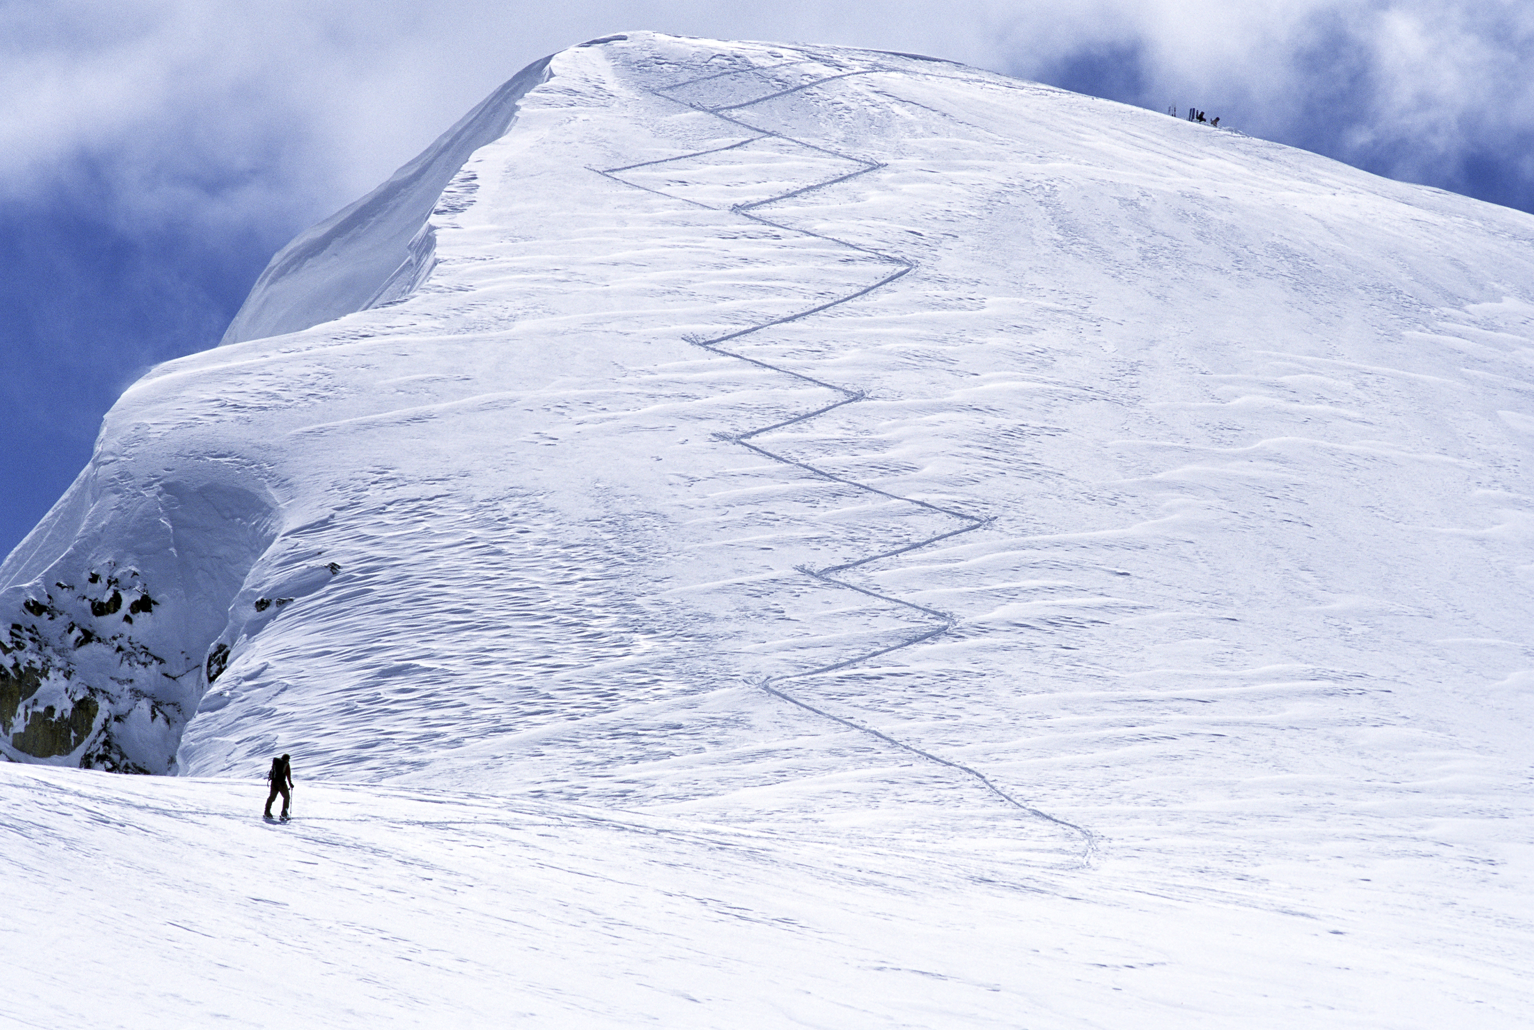
Final Conclusion
The largest gains in pricing support came from increases to vertical drop, as well as runs and chairs available. Future growth should focus on these features to improve revenue.
Alternate gains to revenue could come from shutting down runs, as long as savings exceeds the lost pricing support.

